Slide 1
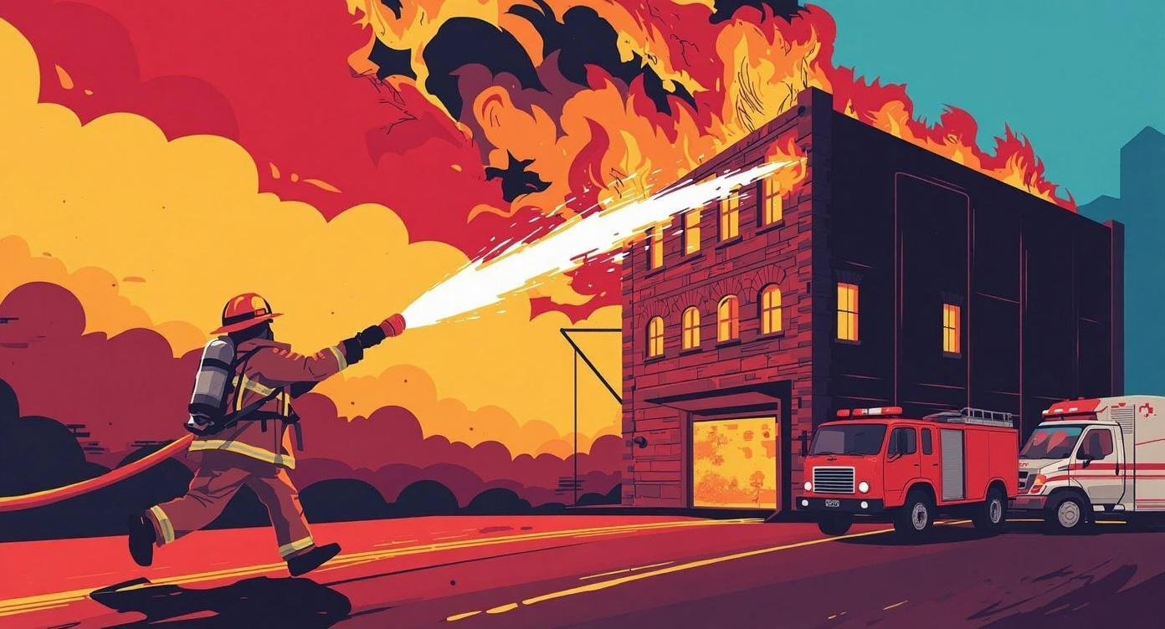
Res-Q AI
Real-time scene clarity for first responders — before wheels touch the ground.
By Tomika “Mickey” Williams — GitHub: ButtaBean11/resq-ai
Notes:
Hi, I’m Tomika “Micley” Williams. I built Res-Q AI because I know firsthand what it’s like to arrive on a scene with incomplete or unclear information. As a firefighter and medic, those first seconds matter the most.
Res-Q AI turns a short dispatcher call into a clean 3–5 bullet hazard summary — incident type, risks, occupancy, and what responders should expect. It’s small, fast on purpose, and designed for real-world emergency workflows.
This prototype shows how AI can give first responders a quick snapshot before they ever step out of the truck.

Slide 2
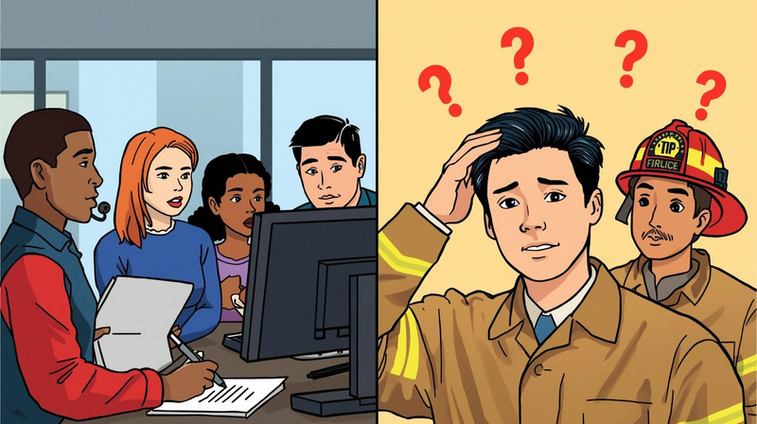
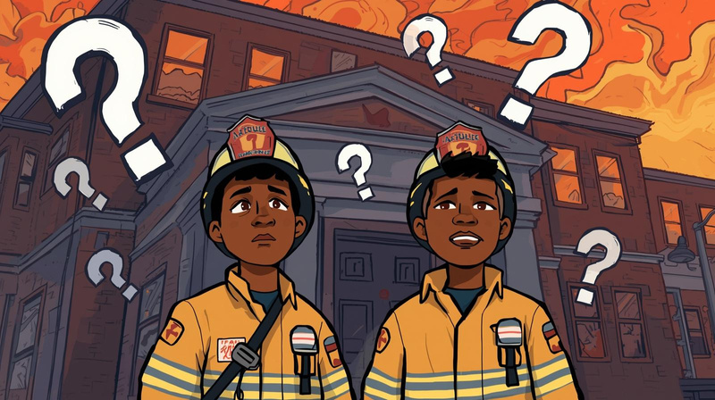
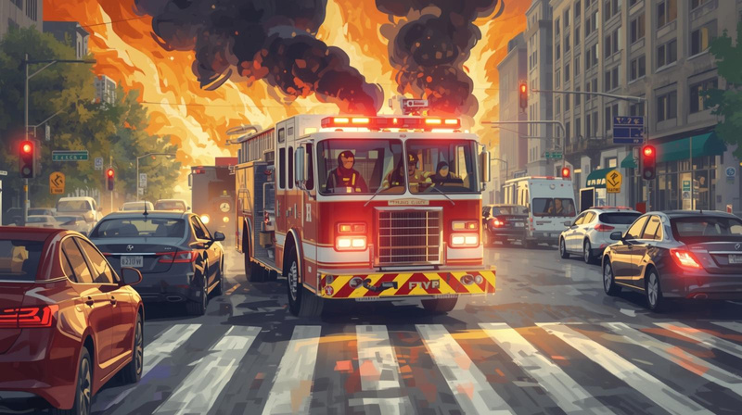
The Problem Nobody Admits
Dispatchers do their best — but calls come in messy, chaotic, and incomplete.
Crews hit the road with half the details and all the pressure.
Frantic callers + unclear details
Crews “guess” what they’re walking into
Delays in the first 2–5 minutes cost lives
Scene confusion = slower, riskier decisions
No real visuals before arrival

Slide 3
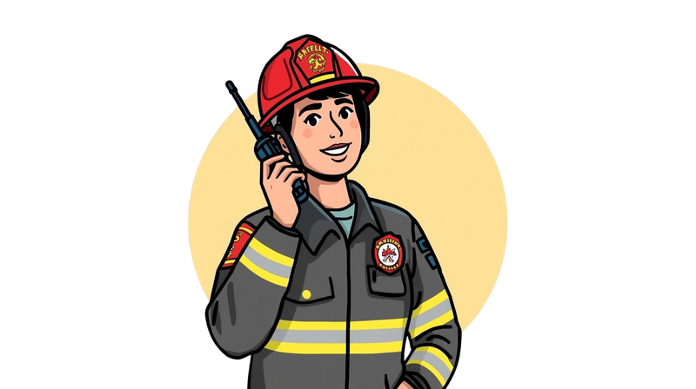


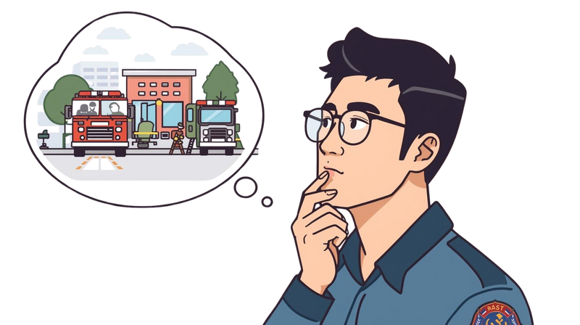
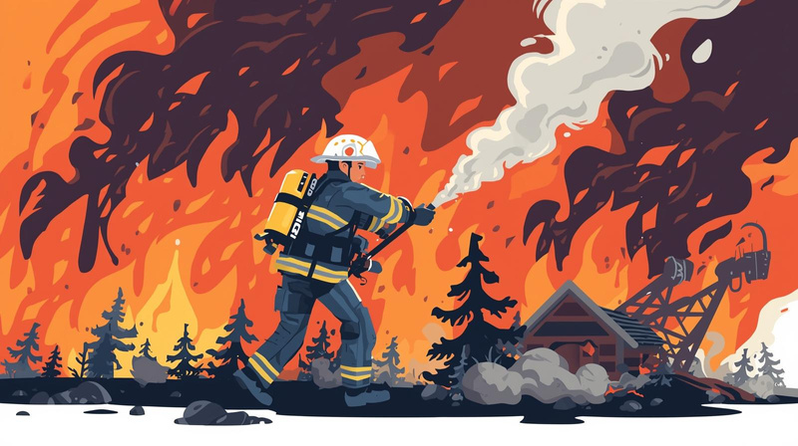
The Blindfold First Responders Are Still Wearing
Radio Call
Cellular Phone
Paper Aerial Maps
Mental Picture
Whole lot of hope
1
2
3
4
5
They need clarity — not guesswork.

Slide 4
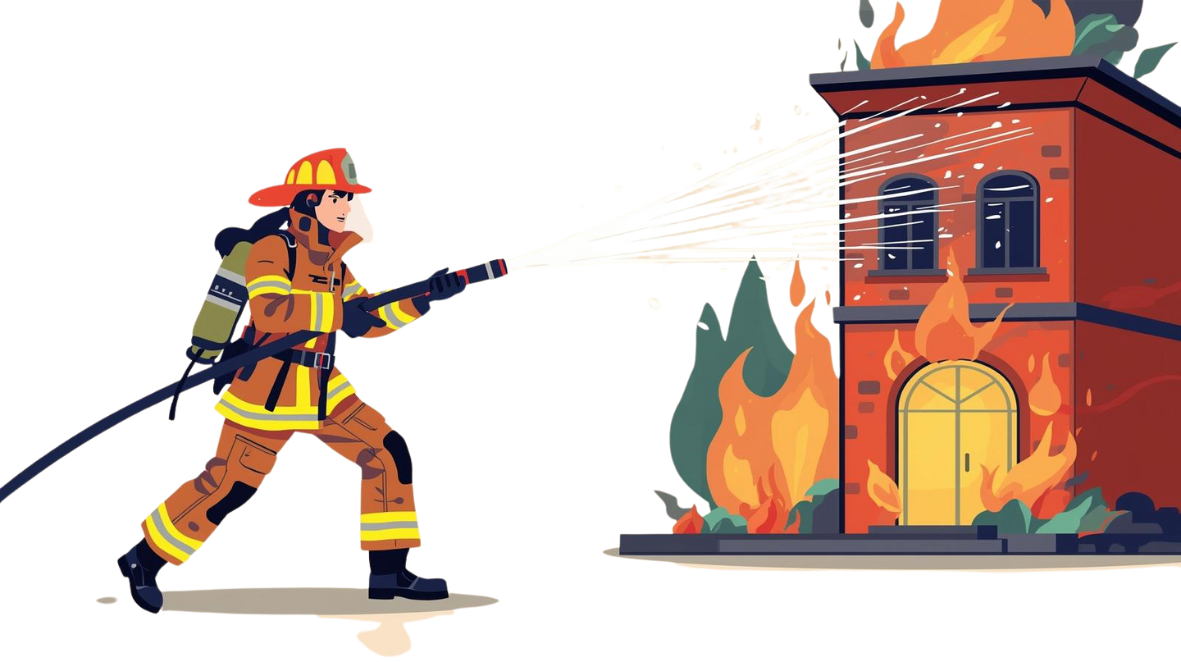
Meet Res-Q AI — Real-Time Scene Intelligence
Res-Q AI turns chaotic dispatch notes into a clean, visual snapshot of the scene — before crews arrive.
Converts call transcripts into simple maps
Highlights hazards & entry points
Estimates number of people involved
Flags environmental risks
Gives crews situational clarity in seconds
Notes:
Res-Q AI takes short dispatcher-style calls and converts them into a clean 3–5 bullet hazard summary - visual snapshot of the scene.

Slide 5

Why Azure AI? Because seconds matter.
Speech-to-Text
Azure Functions
Converts frantic caller audio into structured text
Real-time processing
Secure + scalable for public safety
Vision & Cognitive Services
Azure Maps
Simple floor/area diagrams
Detect hazards + scene indicators
Notes:
gives us the reliability, security, and scale needed to support public-safety environments without cutting corners

Slide 6






How It Works (Simple Flow)
Azure
Speech-to-Text
Azure Function App
Dispatcher Dashboard
Caller Audio
Converts audio to text
Generates scene logic
Azure Cognitive Services
Responder Dashboard
Responder Tablet UI
Extracts hazards, keywords
Displays intel
Displays intel
Notes:
It extracts incident type, hazards, occupancy, and responder risks — nothing extra.

Slide 7
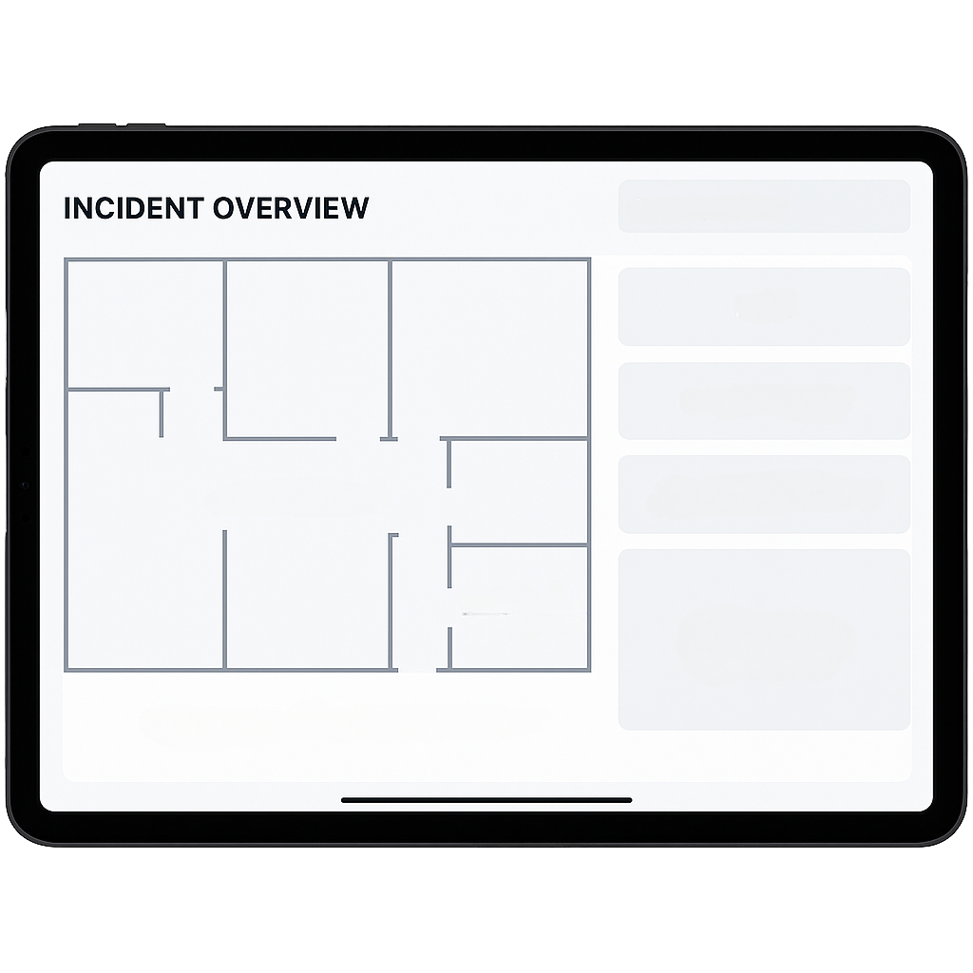





What Res-Q AI Shows Responders
Level Side
3rd Floor RM-3H
Alpha
Risk Level
Triage
STORAGE
RM-3C
HIGH
UNK
Responder Tablet
RM-3E
Caller
One glance situational awareness.
RM-3H
Unknown
Refused to Leave Name/Number
Location
RM-3G
Samson Chocolate & Cane Factory
1234 Rectify Avenue
It Is What It Is, USA, 12345
RM-3B
Notes
Notes
RM-3D
1 Entry/No exit
injury/casualty detected
biohazard on scene/HAZMAT notified
fire on 3rd floor in right corner of back at the end of hallway
RM-3F
Third Floor Entrance
Located on Street Side - Alpha side

Slide 8
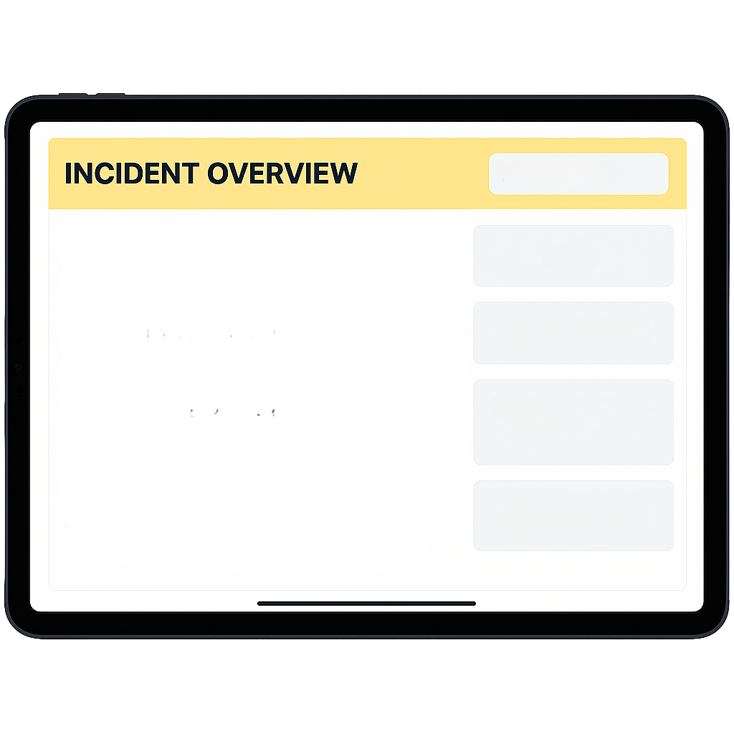
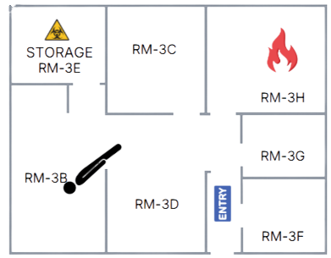
What Res-Q AI Shows Responders
Level Side
3rd Floor RM-3H
Alpha
Risk Level
Triage
Emergency Dispatch
CAD Dashboard
HIGH
UNK
Supports dispatchers without adding workload.
Units Request
Engine 31
EMS 31B
HAZMAT 24
Notes
1 Entry/No exit
injury/casualty detected
biohazard on scene/HAZMAT notified
fire on 3rd floor in right corner of back at the end of hallway
Location
Samson Chocolate & Cane Factory
1234 Rectify Avenue
It Is What It Is, USA, 12345
Third Floor Entrance
Located on Street Side - Alpha side

Slide 9

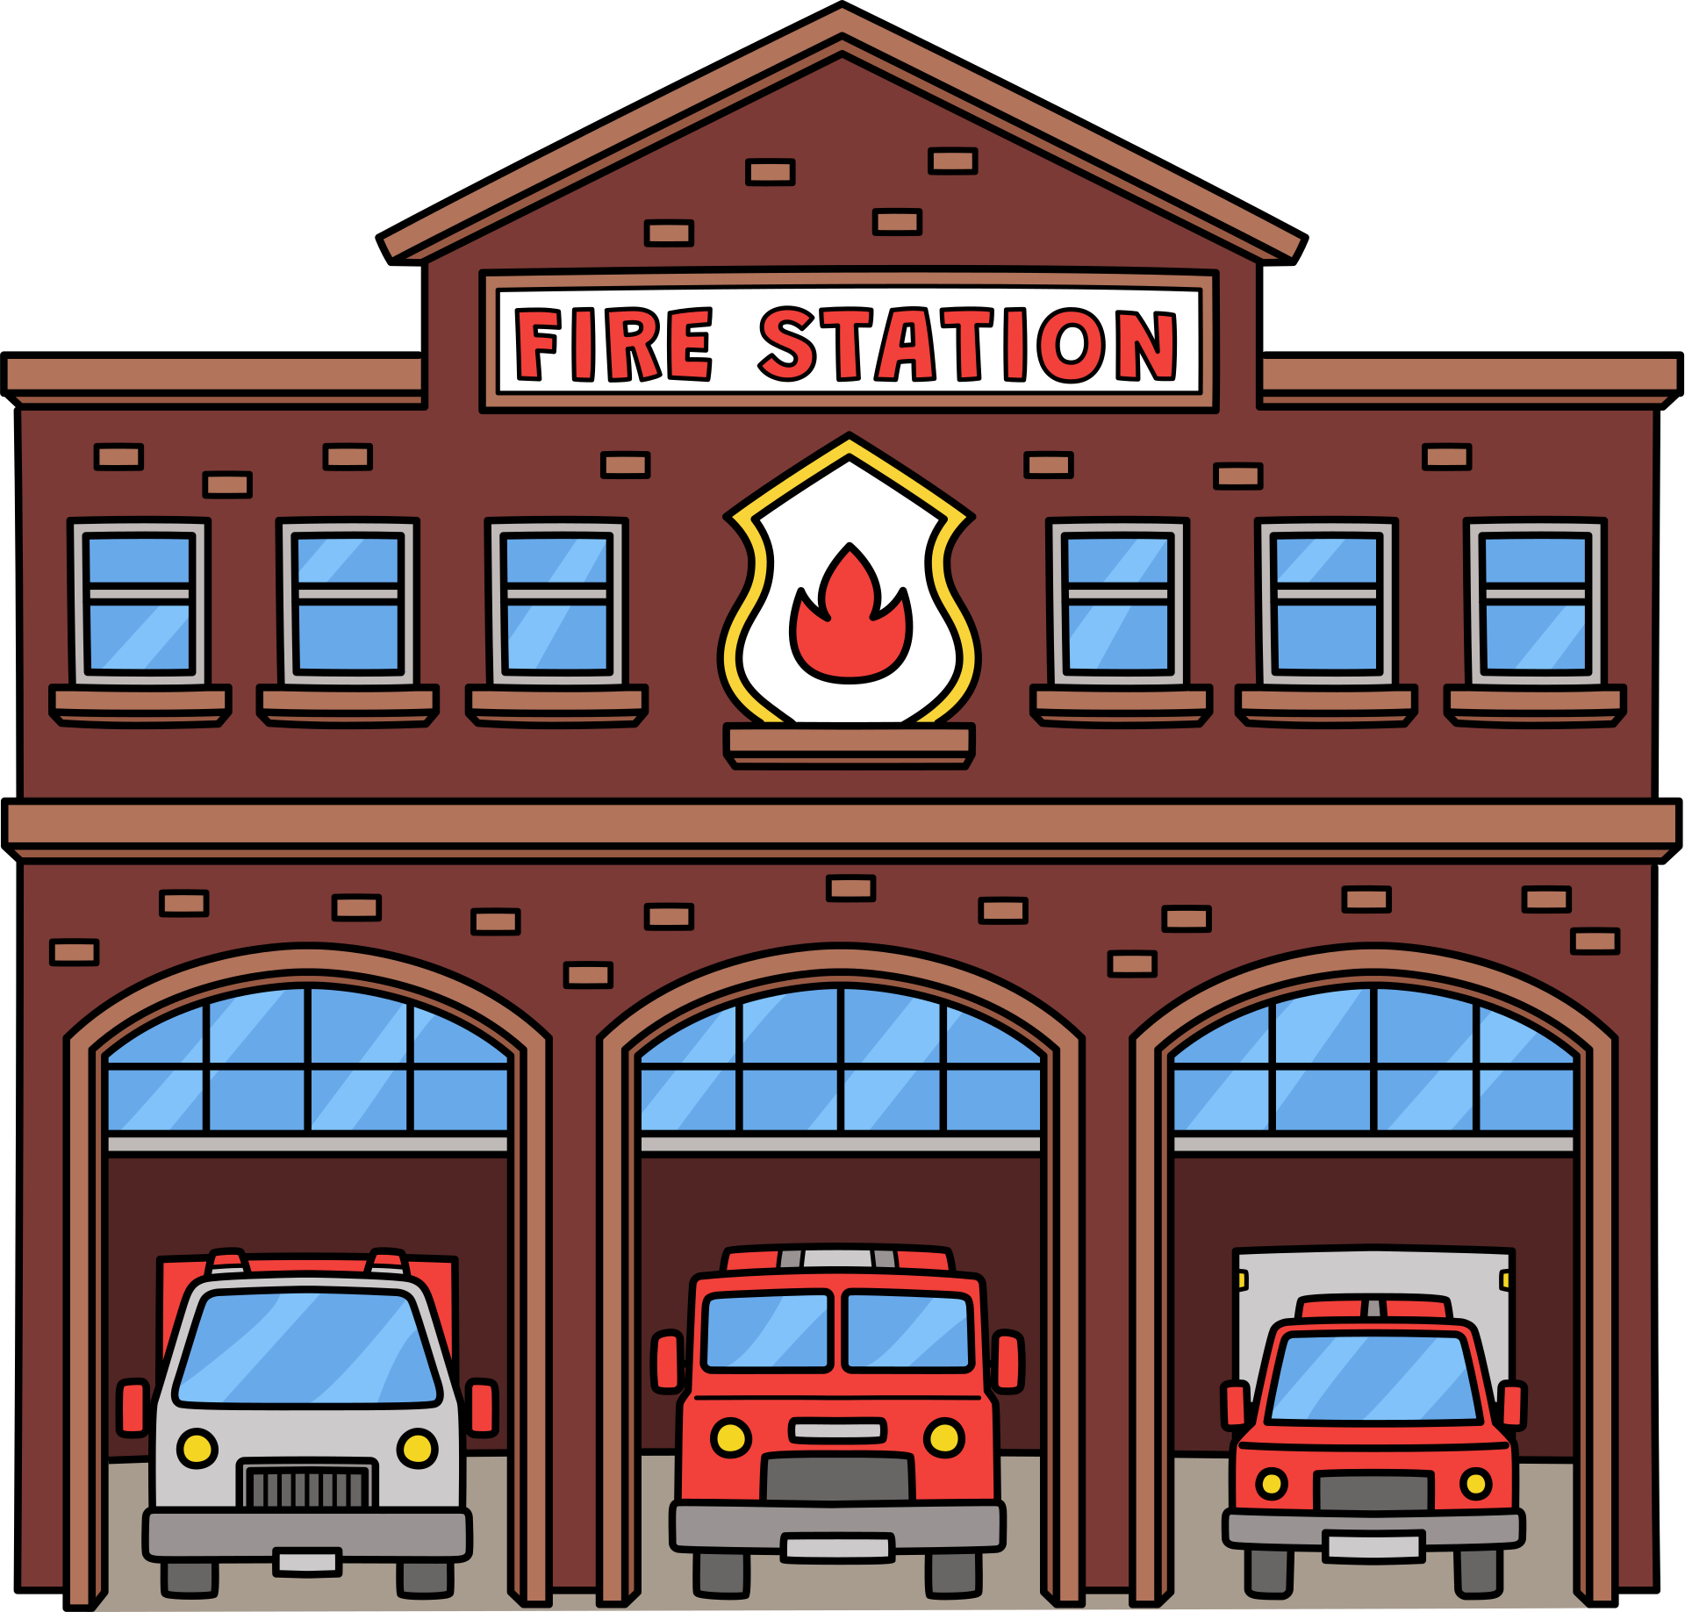

Dispatchers
Communities
Fire & EMS
Who Benefits Immediately
Faster scene understanding
Safer entry decisions
less confusion on arrival
Less cognitive overload
Clearer data outputs
More consistent calls
Faster rescues
Better outcomes
Stronger public safety
Notes:
Faster scene understanding directly affects containment time, treatment priorities, and on-scene safety.

Slide 10


Key Takeaways From Building Res-Q AI
Real problems need real, field-tested solutions
Simple visuals make a major difference in emergency response
Azure AI tools speed up build-time dramatically
Simple > fancy in high-pressure environments
Good AI enhances responders — never replaces them
Notes:
It gives crews a fast snapshot before stepping off the truck. Simple, fast, and designed for real emergency workflows.

Slide 11

Res-Q AI isn’t magic.
It gives responders the real-time information they should’ve had all along.
Thank
You
GitHub: https://github.com/ButtaBean11/resq-ai
Contact: Tomika “Mickey” Williams

